Slide 1
Android Training Program
The Platform Overview

Slide 2
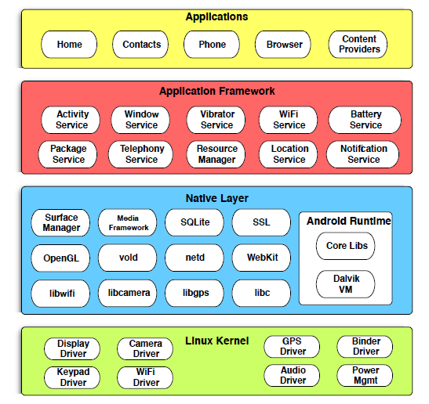
Android Stack Overview

Slide 3
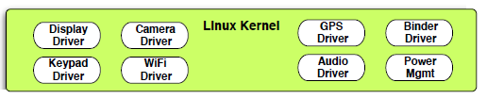
Kernel Layer
Based on the Linux Kernel 2.6
Provides services such as:
Permission based security model
Memory Manager
Process Management
Network Stack
HAL for Device Driver development

Slide 4
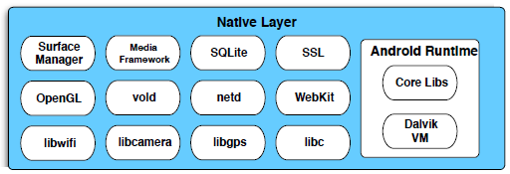
Native Layer
A custom libc implementation named Boinic
3rd party open source libraries like Webkit, SQLite, OpenGL etc
Linux system daemons for telephony, networking, sensors etc.
Native Development Library (NDK) exposes API access into this layer.
Notes:
Boinic is NOT POSIX compatible

Slide 5
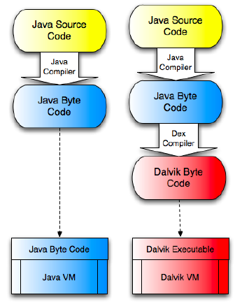
Native Layer: Android Runtime Environment
Supports Java programming language as primary
Dalvik VM is a clean-room implementation of a Java VM (but Oracle said “nope” and sued)
Each app on the device hosted on its own instance of Dalvik VM (ensures security sandbox)
Dalvik VM runs Dalvik Executables (.dex)
Java bytecode != Dalvik bytecode
Bytecode-to-bytecode transformation via the dx tool, packaged into a APK using the aapt tool
Eclipse ADT plugin is pre-configured to handle this all for you
P.S: Since version 2.2 (Froyo), the runtime has a Just-In-Time (JIT) compiler.

Slide 6
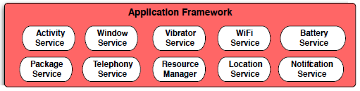
Application Framework Layer
Classes for implementing application components
"Manager" classes for accessing Android system services such as Bluetooth, cameras, sensors, WiFi, etc.
"Wrapper" classes for native libraries such as OpenGL and SQLite
Most standard Java SE packages
Auxiliary packages such as JSON and XML parsers and the Apache HTTP Client
* Most of the Java packages were based on the Apache Harmony Project

Slide 7

Application Layer
Consists of pre-installed system applications and user-installed applications.
System and user-installed applications have the same structure and are built on the same application framework layer.
System applications have access to some private framework APIs not exposed to third-party application developers.
System applications can’t be uninstalled by the user.

Slide 8
Application Structure
Android application are a single file, known as an application
package or APK, containing:
Dalvik executable code compiled from your Java source code
Resources, such as images, audio/video clips, as well as numerous XML files describing layouts, language packs, and so on
Optional native shared libraries, compiled from C/C++ source code using Android’s NDK.

Slide 9
Application Signing
APKs must be signed with a security certificate before they can be installed on a device.
During development, Eclipse will automatically create a debug certificate for you.
For production, you’ll use a self-signed certificate that you generate
Google recommends a validity period of 25 years
DO NOT LOSE YOUR PRODUCTION CERTIFICATE ONCE YOU HAVE DEPLOYED YOUR APP TO DEVICES. GUARD THEM WITH YOUR LIFE!

Slide 10
Questions?

Slide 11
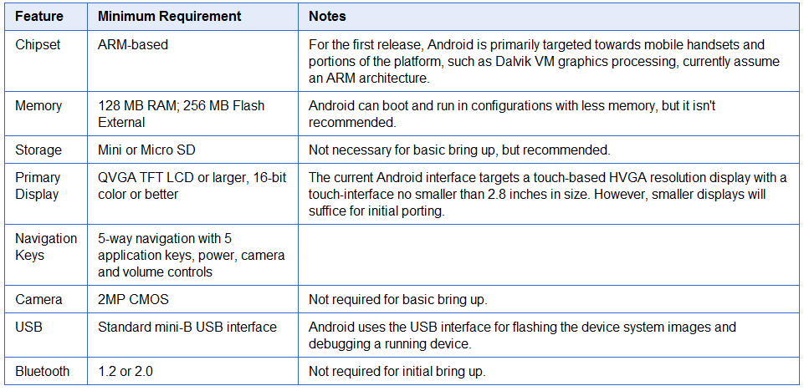
One Last Thing: Device Requirements for Building an Android ROM

